Slide 1
The existential FMCG challenge:
We are all in this together
Martial Rolland

Slide 2



The new reality of FMCG
At the high end
Consumer shift away from big brands
At the entry level
Private labels & promo pressure on brands

Slide 3
Growth is scarce and
resource is tighter than ever
REAL DISPOSABLE INCOME*
NEGATIVE RETAIL
SALES
FOOD INFLATION**
-12%
2 years
+2.6%
* Dynamics 2017 vs 2015 ** August 2017, YoY

Slide 4
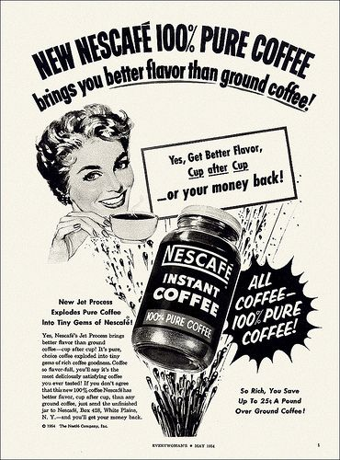
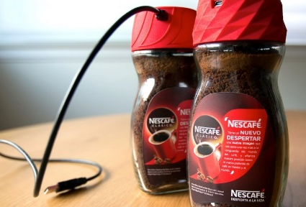
The world of advertising has changed
Print Age
TV Age
Digital Age
Product Benefit
Rational Appeal
Brand Building
Emotional Appeal
Personalized Experiences
Emotional & Rational Appeal

Slide 5






POWERED BY Technology
Technology brings opportunities | Technology brings CHALLENGES
Precision targeting | Fragmentation
Consumer insight | Data overload
Analytical rigor | Operational complexity

Slide 6
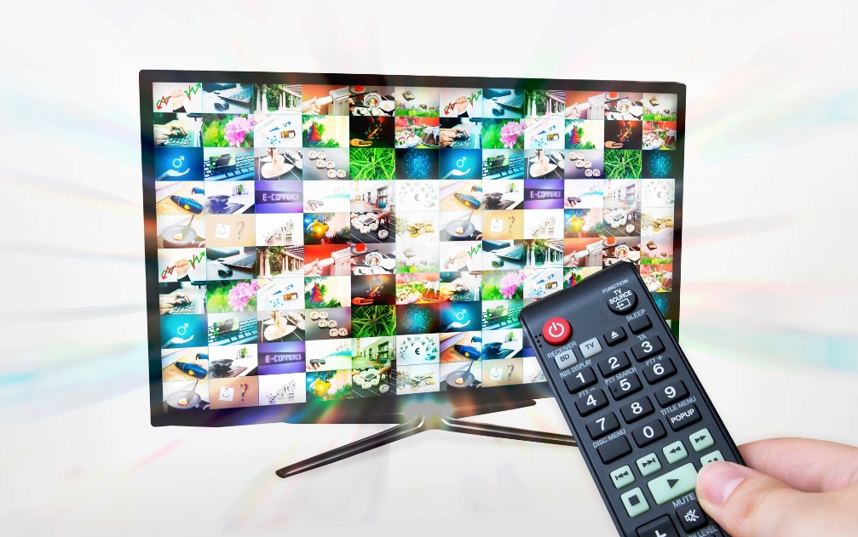

We need both MEDIA ENGINES TO WORK
Brand building equity / Mass reach
Personalization / Direct Response

Slide 7

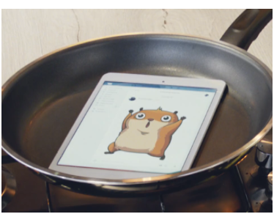
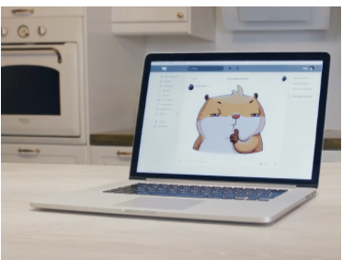
AND CONTINUE TO DEVELOP THEM
GLOBAL LEARNINGS: DIGITAL & TV ROI
INNOVATIVE CAMPAIGNS IN DIGITAL
3 sec online video
Unaided Brand Awareness 12pts
Top of Mind Brand Awareness 16pts
* Various markets
Source: Analytic Partners, Marketing Mix Modelling

Slide 8
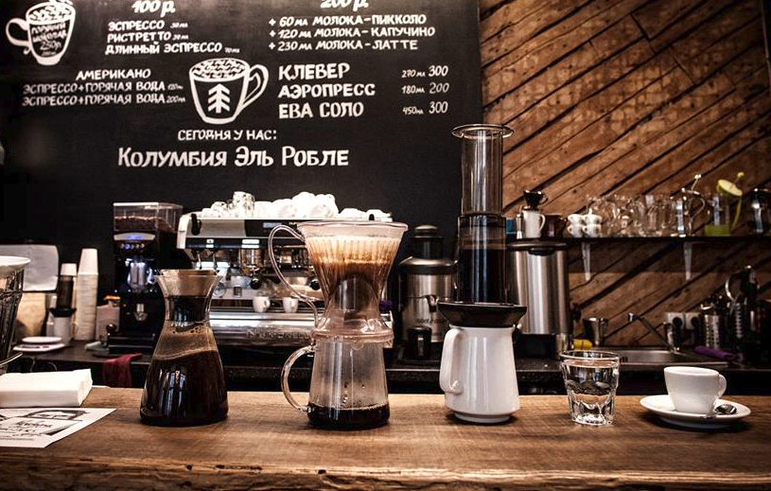







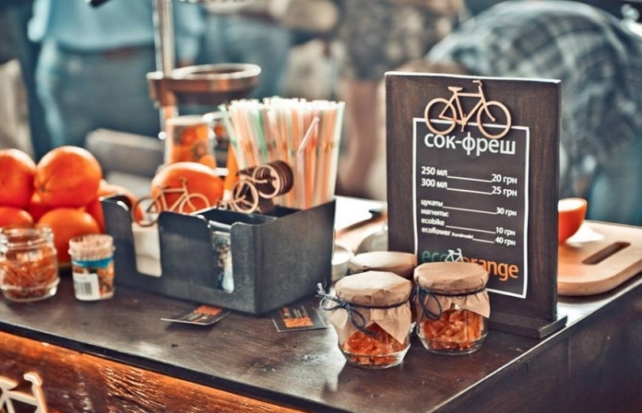
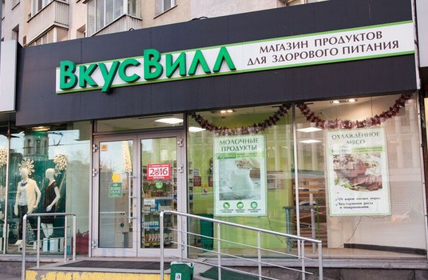



Our long term health BRINGS revenue FOR MEDIA PARTNERS. COST & EFFICIENCY ARE KEY FOR OUR HEALTH
> Billions
Big Brands AD SPENDS
< Millions
‘Craft’ Brands AD SPENDS

Slide 9
THANK YOU

